Slide 1


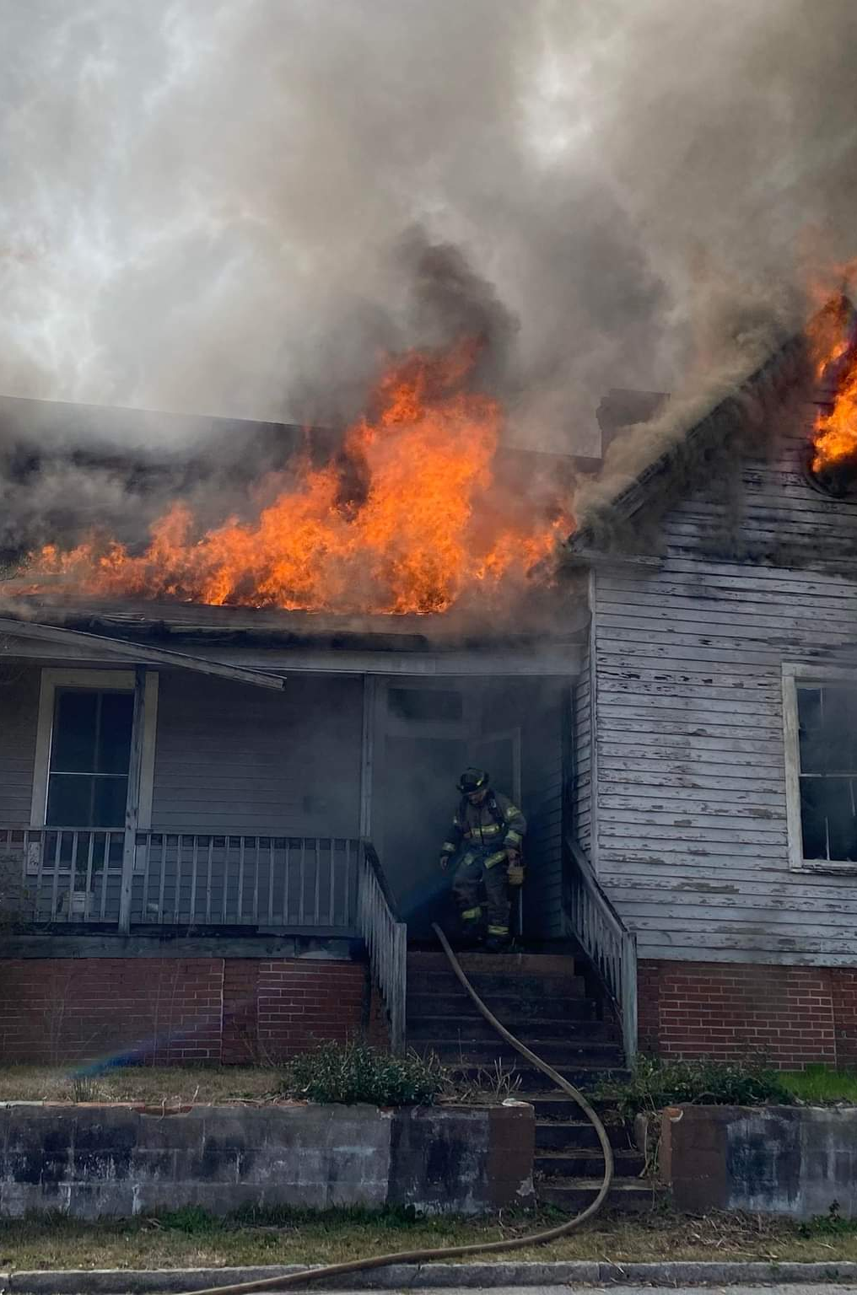
Macon-Bibb County Professional Firefighters
IAFF LOCAL 121

Slide 2

Macon-Bibb County Professional Firefighters IAFF Local 121
Labor Union representing every man and woman employed with the Macon-Bibb County Fire Department
The organized voice of firefighters
An advocate for firefighters and firefighter families

Slide 3
What our mission means
Positive Change Through Working Together ( Union Activities )
Building Relationships with Decision Makers ( Political Activity )
Health and Safety Training ( Bringing Resources to MBCFD )
Taking Care of Our Neighbors ( Charitable Activities )

Slide 4
Current Membership
Just over 57% of sworn MBCFD personnel are members of Local 121
Membership continues to grow daily!

Slide 5
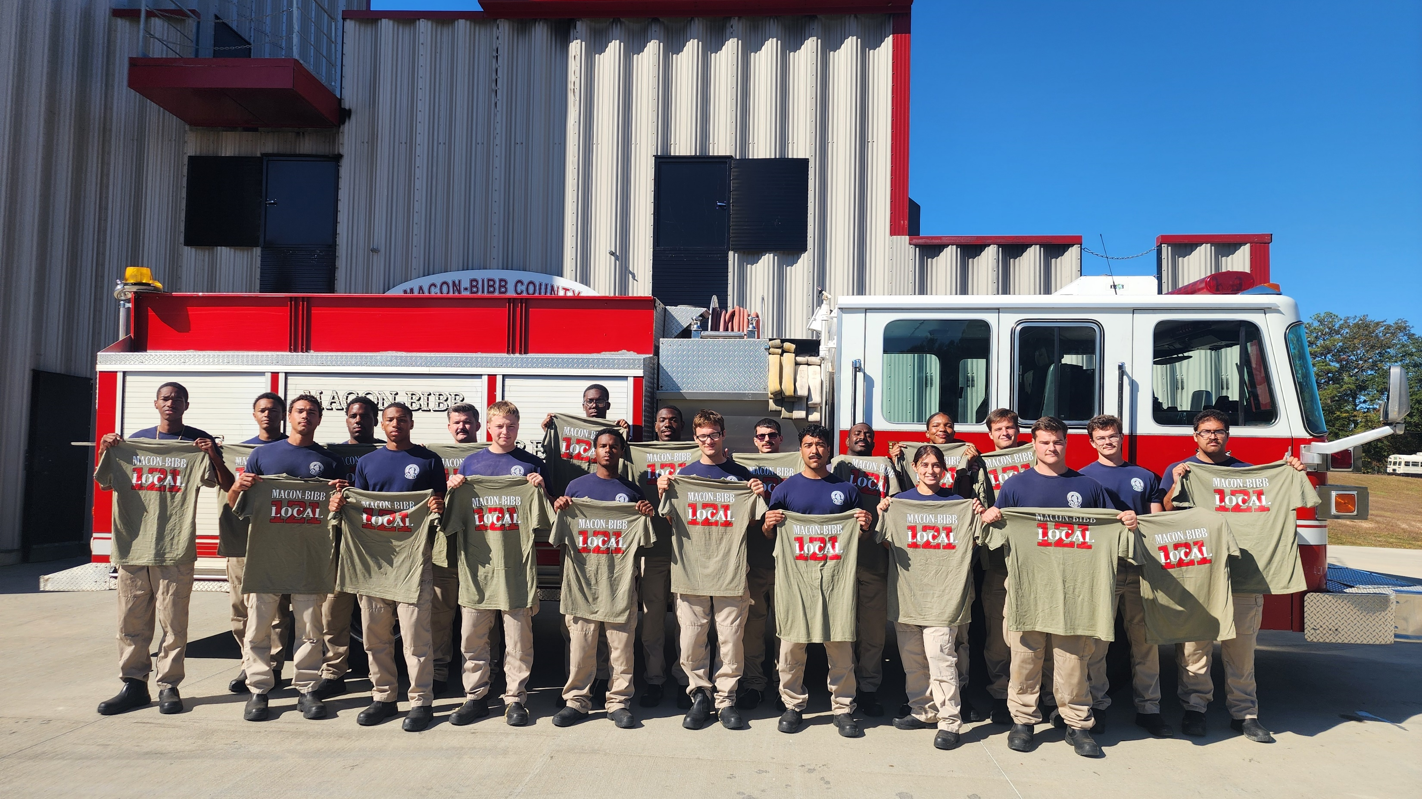
90.9% of recruit class 2502 joined local 121 in 2025!

Slide 6
When you join The Local 121 your apart of 3 organizations
International association of firefighters
Professional firefighters of Georgia
Macon-Bibb County firefighters association – local 121

Slide 7

International association of firefighters
Founded in 1918
358,000 Members in the US and Canada
with over 3,500 Local Chapters
85% of Career Firefighters
Provides Benefits, Technical Resources and Lobbying

Slide 8
Resources
Representation:
Assistance w/ contract negotiations, grievances, arbitration, internal communications, and other union business.

Slide 9
Resources
Financial Analysis:
Getting information on wages, benefits, and working conditions to use in negotiations, arbitration, and meetings with decision-makers.

Slide 10
Resources
Communications:
Assistance in developing union messages and communications to members, the media, elected officials, and the public.

Slide 11
Resources
Legal Injunction:
Legal representation against unfair discipline for union-related activities.

Slide 12
Resources
Data Evaluation:
GIS mapping, EMS system evaluation, workload analysis, and other data assessments to help educate decision-makers about public safety and the importance of adequate staffing and resource deployment.

Slide 13
Resources
Political and Legislative:
Assistance in enhancing and growing political capital, including power mapping, running electoral campaigns, and understanding campaign finance (e.g., local and state political action committees).

Slide 14
Resources
Health and Safety:
Provide experts and resources in information for illness/disease, occupational cancer awareness/prevention, behavioral health, safe staffing, disaster relief, health/wellness, building codes, etc.

Slide 15
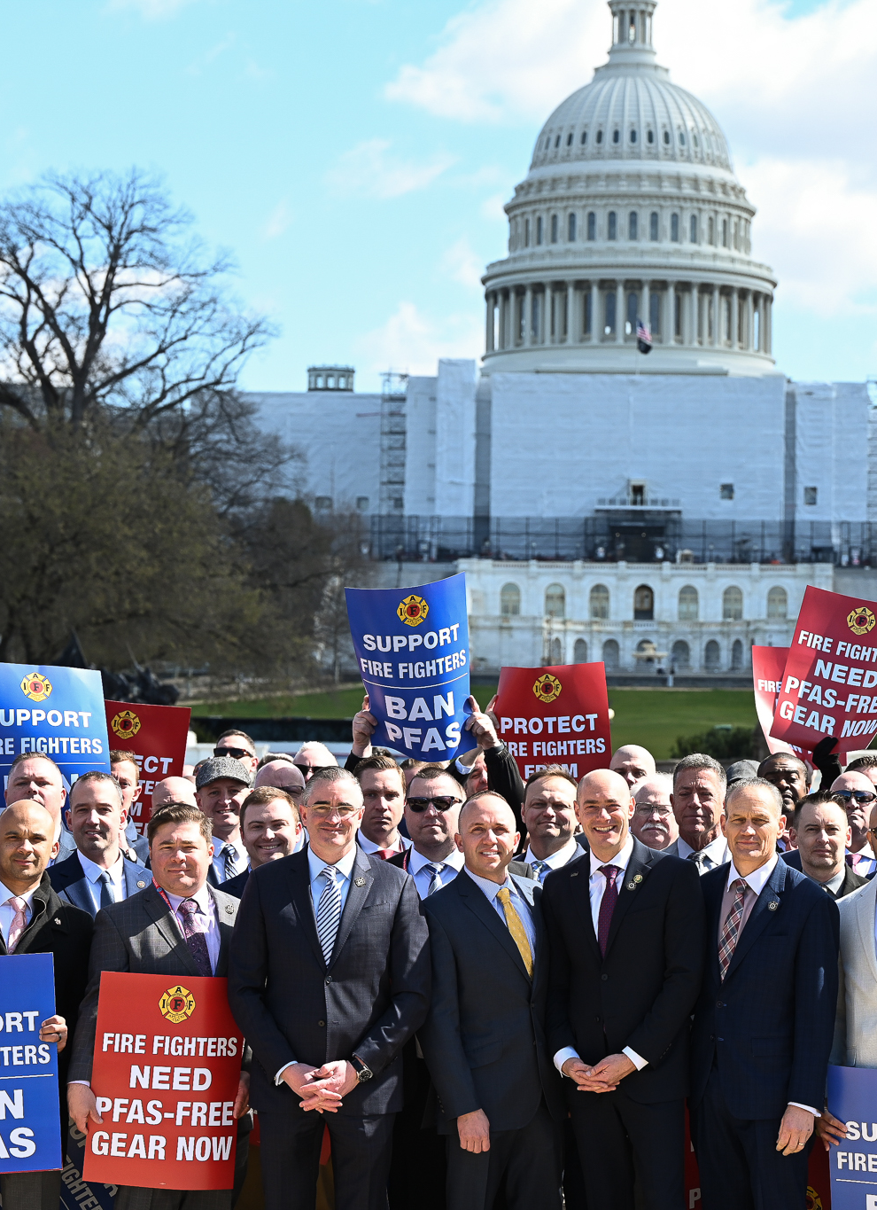
Current iaff initiatives
Public safety free speech act ( hr-7398 )
H.R.7398 - 118th Congress (2023-2024): Public Safety Free Speech Act | Congress.gov | Library of Congress
Support Survivors of Fallen Public Safety Officers
Our Fallen Heroes Act (S. 930/H.R. 1719) to recognize first responders’ occupational cancer deaths as line-of-duty deaths and provide death benefits to their survivors.
Fighting for increased safety, education and training
Support the Development of Next-Generation Protective Gear
Pfas in turnout gear advocacy

Slide 16
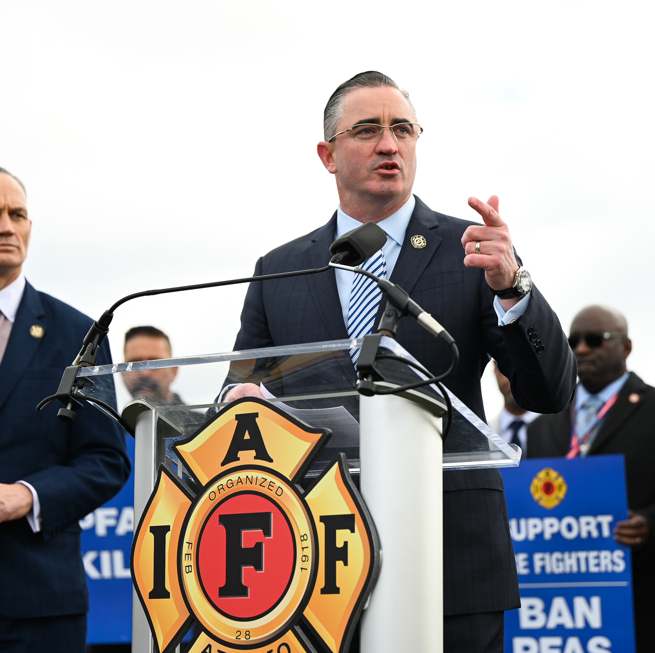
Recent iaff wins
Fire Grants and Safety Act
Reauthorized essential grant programs for fire department staffing and equipment.
Won funding for 350 million to replace afff foam
DOT/NTSB improved rail standards and safety for first responders
Federal jury awards $1 million to IAFF members fired for union organizing

Slide 17

Professional firefighters of Georgia (PFFG)
Advocates and lobbies at the ga state Capitol FOR ALL FIREFIGHTERS IN THE STATE OF GEORGIA
Current pffg initiatives:
Firefighter bill of rights that protects firefighters and sets standards for disciplinary action
Working on expanding and increasing the state firefighter pension

Slide 18
Professional firefighters of Georgia wins
Cancer bill
Ptsd bill

Slide 19
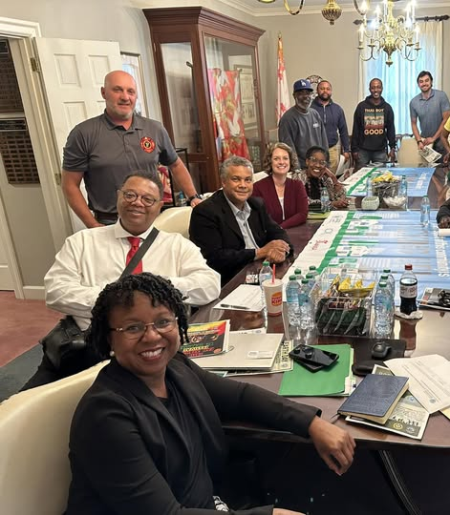
Political action
Most fire fighters didn’t sign up for the job to be involved in politics. Though every decision made about our work – safety, pay and benefits, union rights, retirement security, and more – is made by someone who was elected or appointed by someone elected. Politics is a tool that we must use to build power.

Slide 20
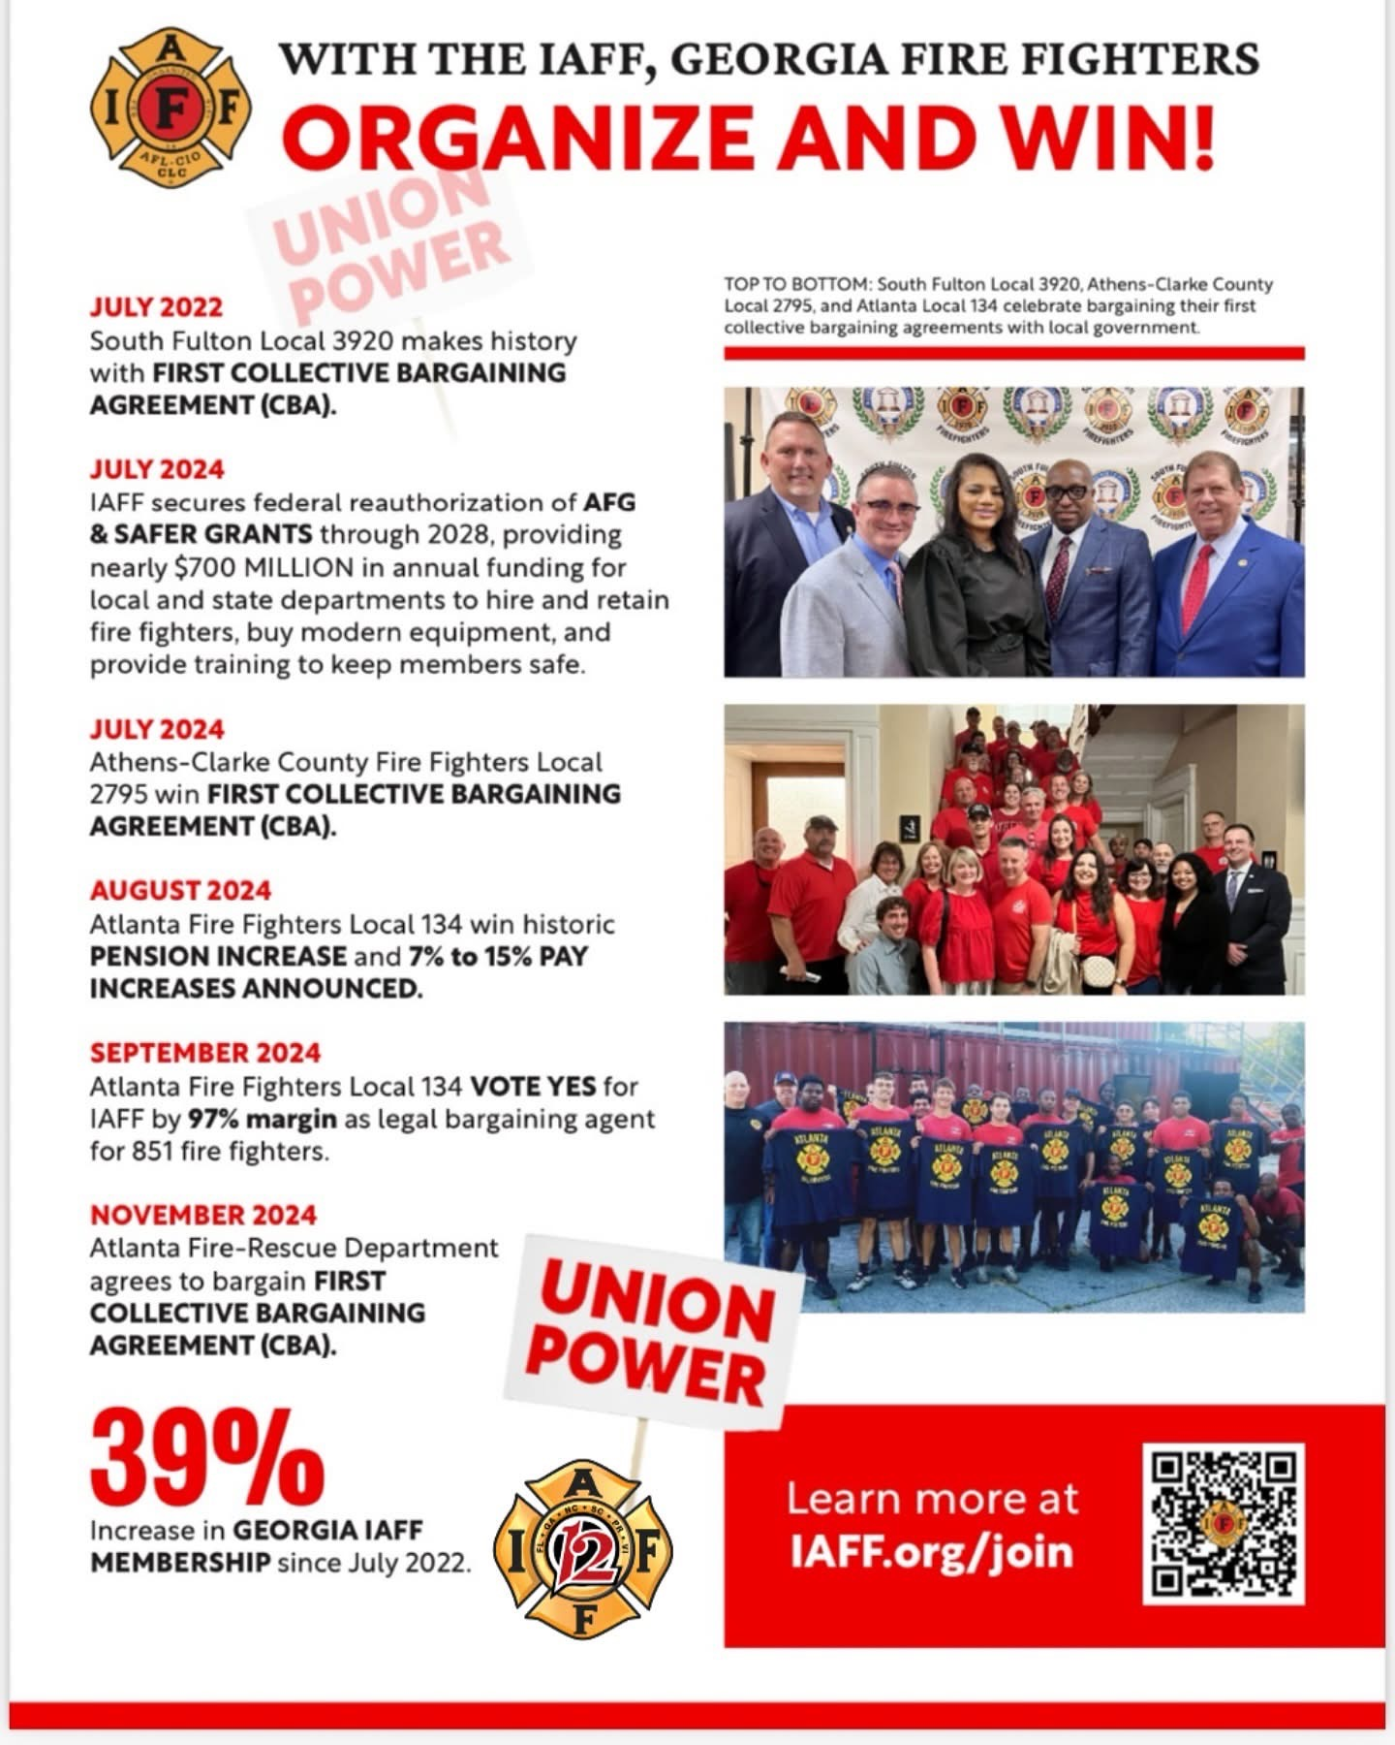

Slide 21
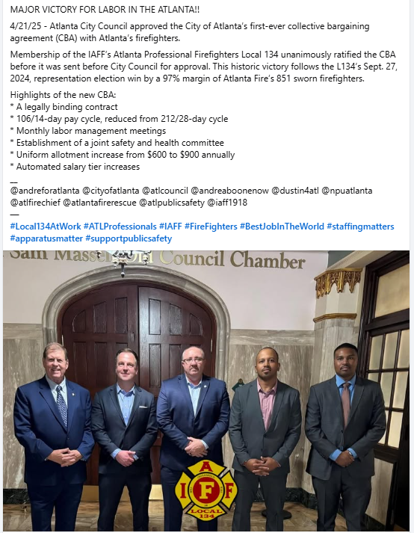

Slide 22
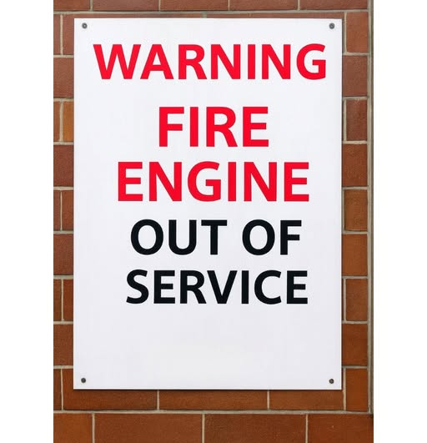


Slide 23
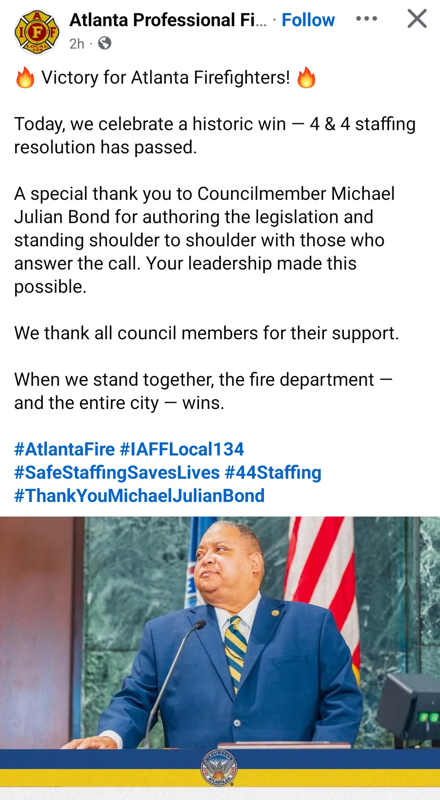
10/20/2025

Slide 24

Local 121 fundraising and volunteer efforts

Slide 25
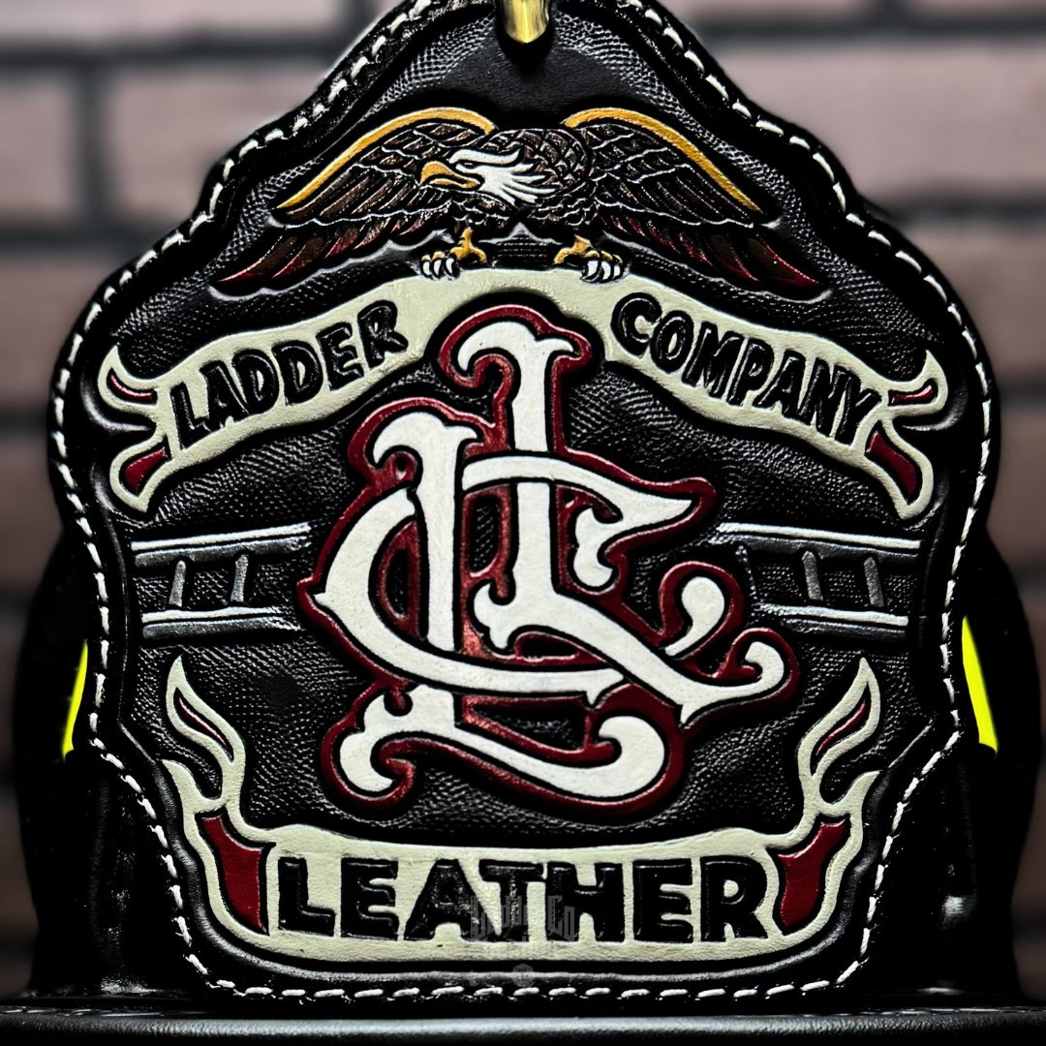
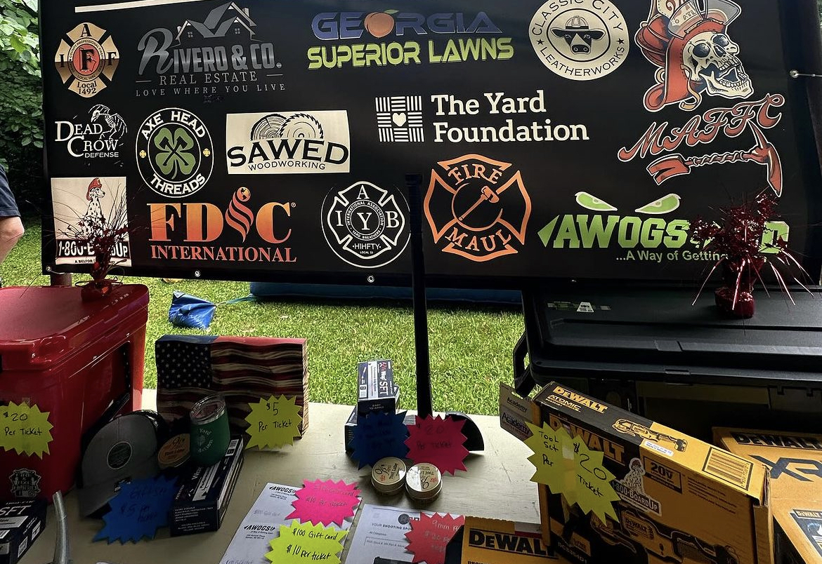
Partnerships and sponsors allow for very successful fundraising

Slide 26
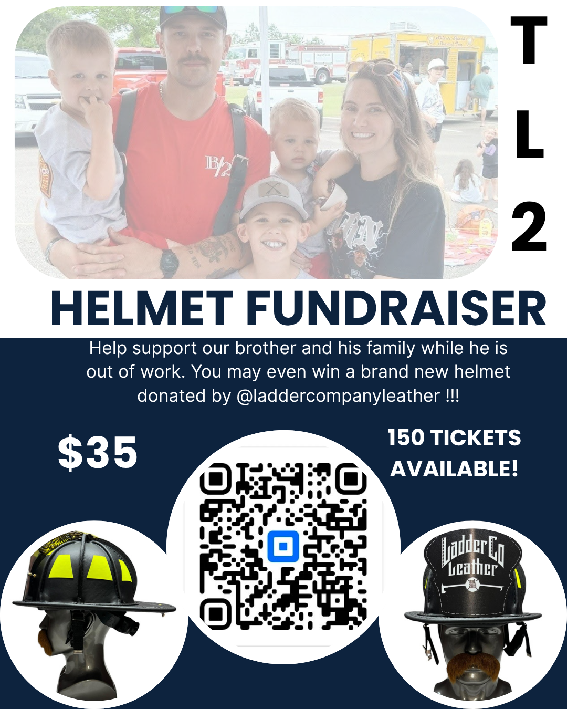
fundraising
When times are tough, we rally behind our members to provide them financial assistance. Through our fundraising efforts and grant applications. Over $5000 raised thus far in 2025.

Slide 27
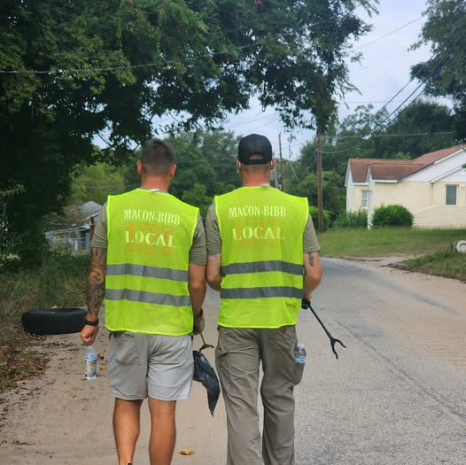
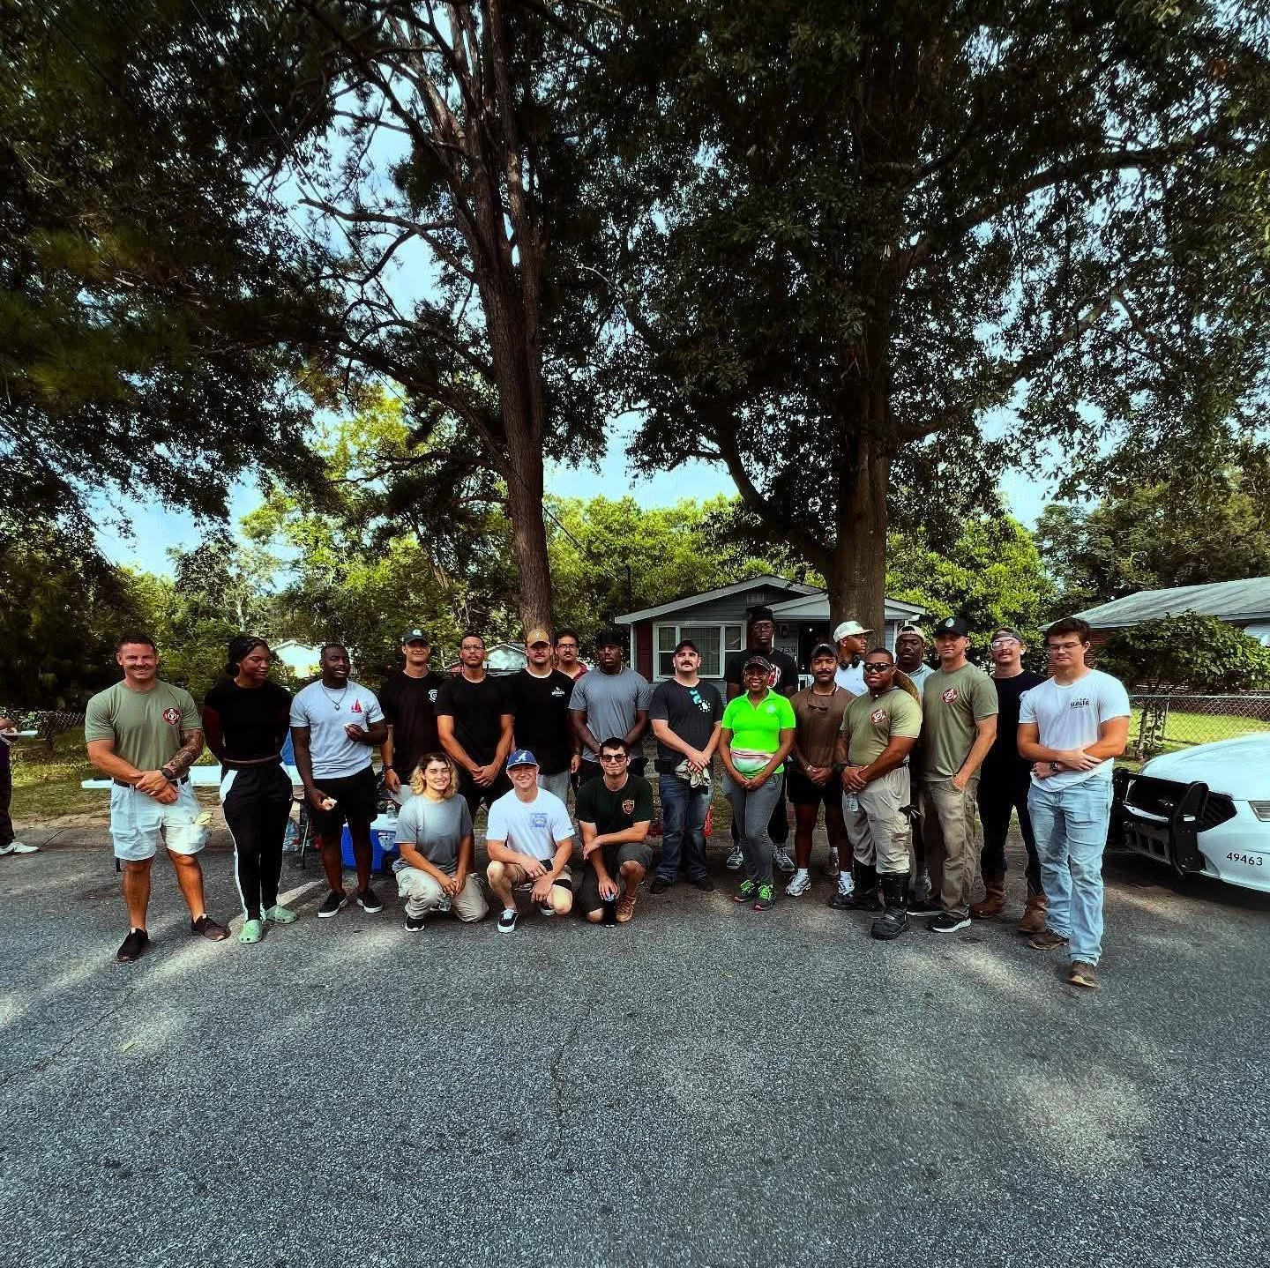
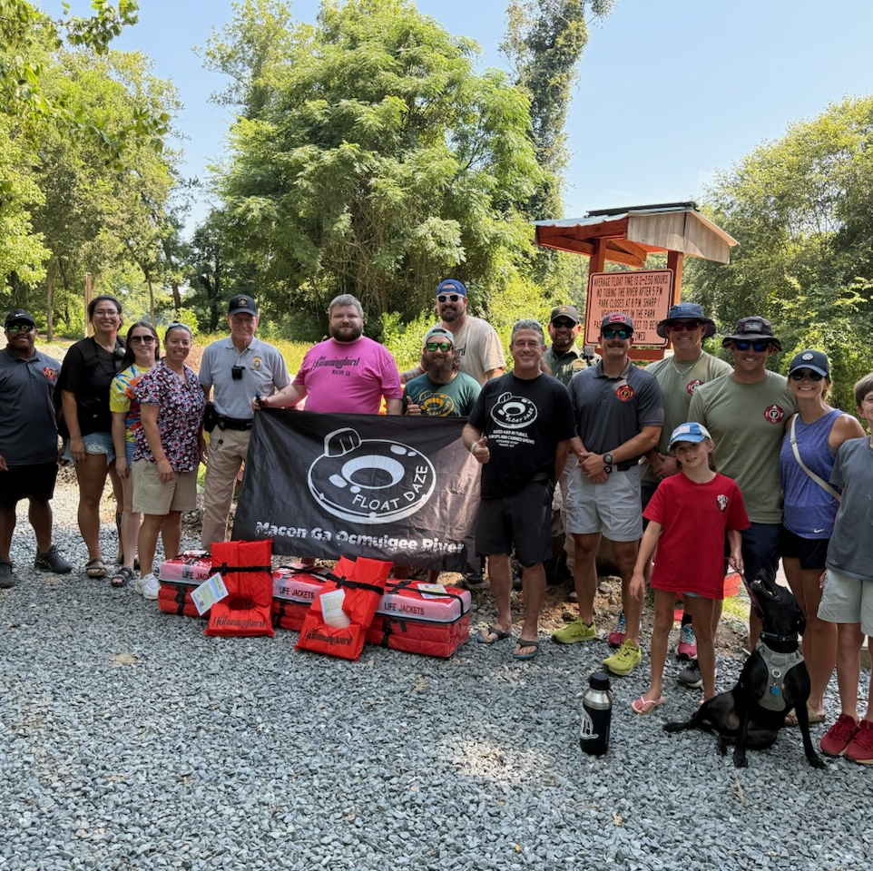
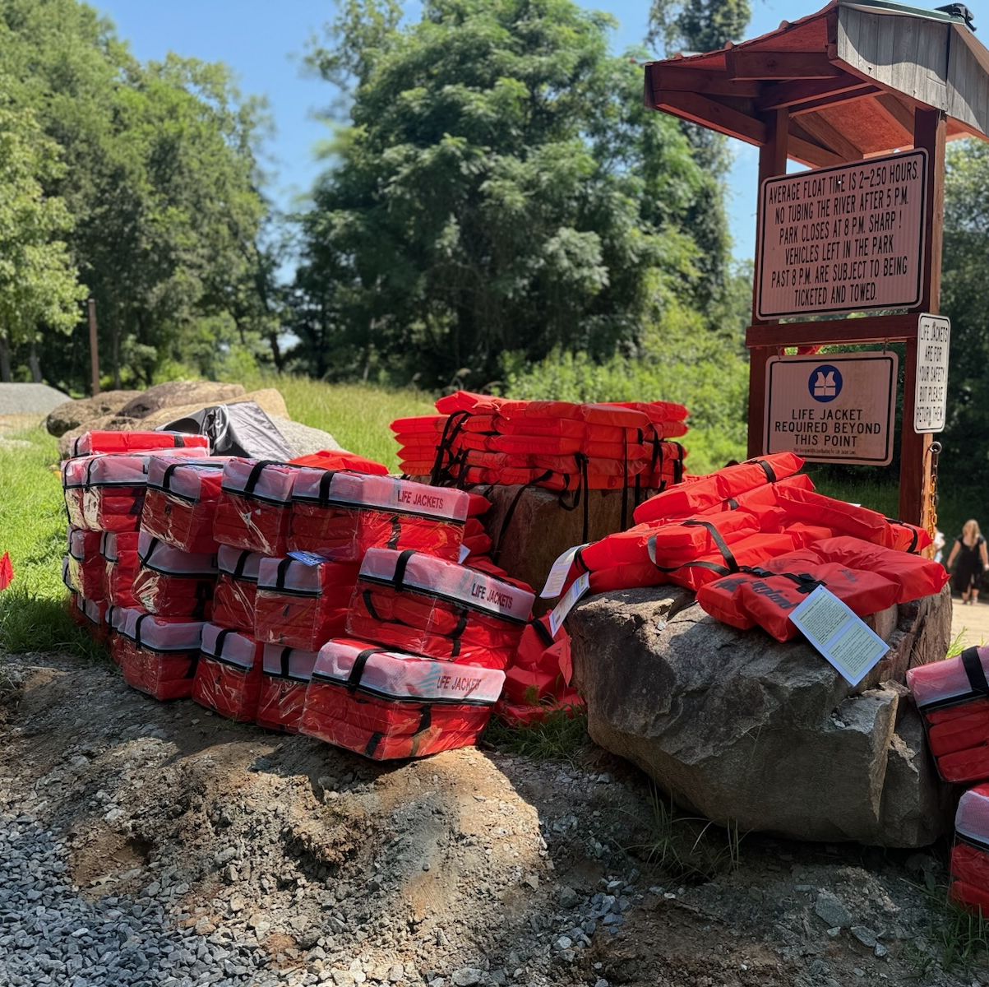
volunteering
Being out in the community assist with our efforts to not only help others, but to produce partnerships with the communities, elected officials, and the voters we need to make the local 121 strong.

Slide 28

Networking and conferences
members of Local 121 attend numerous conferences throughout the year hosted by the iaff and state associations. Through education and networking, we gain knowledge and strength.

Slide 29
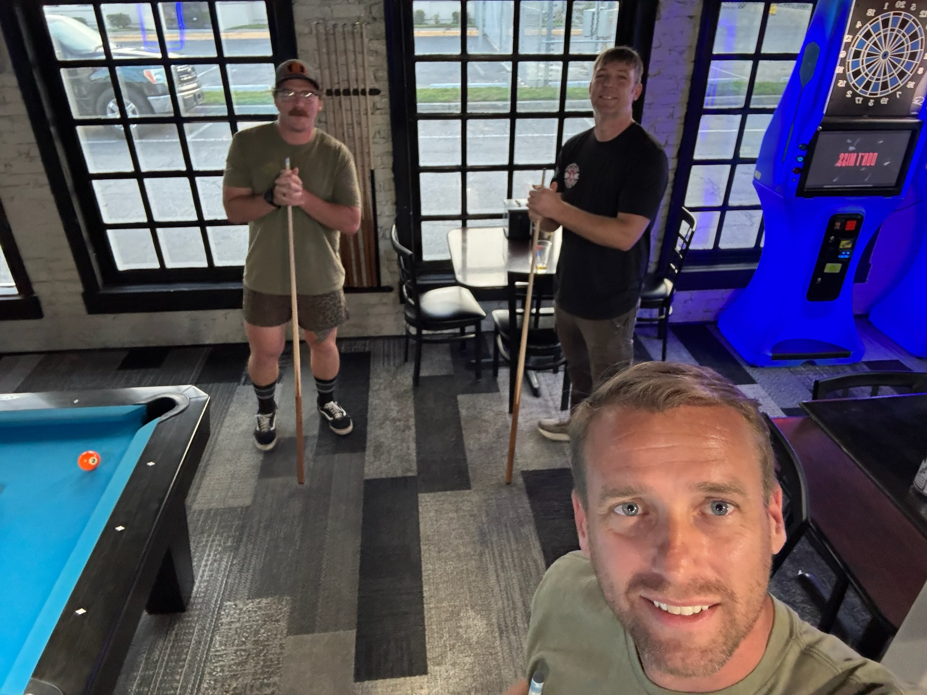

Local 121 socials
Family like atmosphere is what its all about. We are here for each other inside and outside the department. Local 121 host meetups and events to relax and bring camaraderie to our department.

Slide 30
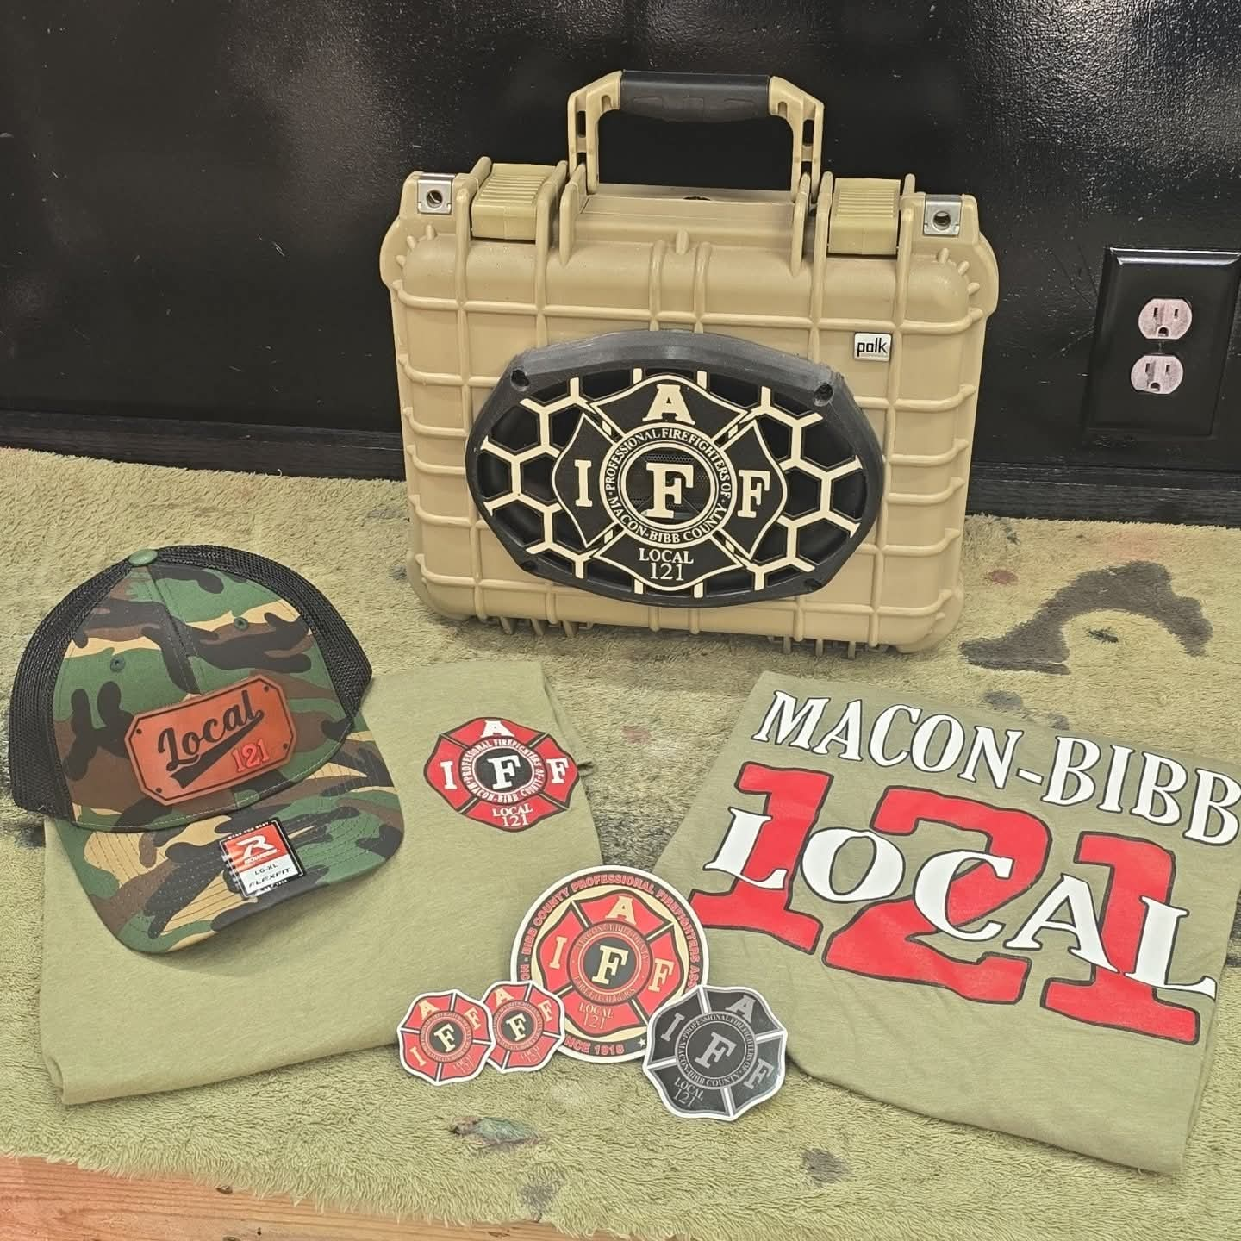
Benefits of membership
Education and training – the iaff offers in person and online education and training programs
Outside training opportunities
Iaff financial core discounts and benefits
Local 121 Scholarship
Unionplus.org consumer discounts and benefits
Legal advice and representation – fmla, flsa, disciplinary action
W. H. “Howie” McClennan Scholarship
Iaff center of excellence
Iaff foundation – disaster relief
Emergency Funding
Of course, the merch!!!

Slide 31
Breakdown of dues
$30 Monthly or $15 per pay period ( equates to $7.50 per week )
$17 to the IAFF ( Iaff sets per cap at 1% of average salary )
$13 to Local 121

Slide 32
WELCOME!!!
Visit maconbibbfirefighters.org
Click on the “IAFF MEMBERSHIP” tab to fill out information to sign up
Once complete; click on the “Register” tab and fill out

Slide 33
Committee Members:
1A - Sgt. Brandon Pate
1B - Sgt. Josh Watts
1C - Lt. Brandon Teague
2A - Pvt. John Gallagher
2B - Lt. Ryan Ramsdell
2C - Sgt. Ron Pryor
3A - Sgt. Taiwan Bell
3B - Sgt. Joseph Hall
3C - Currently Vacant
Training - Sgt. Daniel Hall
Prevention/Administration - Pvt. Tammie Cravey

